Slide 1

RUNGTA COLLEGE OF DENTAL SCIENCES & RESEARCH
CROWNS IN PEDIATRIC DENTISTRY
DEPARTMENT OF PEDODONTICS AND PREVENTIVE DENTISTRY

Slide 2
SPECIFIC LEARNING OBJECTIVES
Core areas | Domain
Introduction Stainless steel crown Bonded crown | Shell crown Strip crown

Slide 3
CATEGORY
MUST TO KNOW
NICE TO KNOW
Strip crowns
DESIRE TO KNOW
Recent development for crowns in pediatric dentistry
Introduction
Stainless steel crown
Bonded crown
Shell crowns

Slide 4
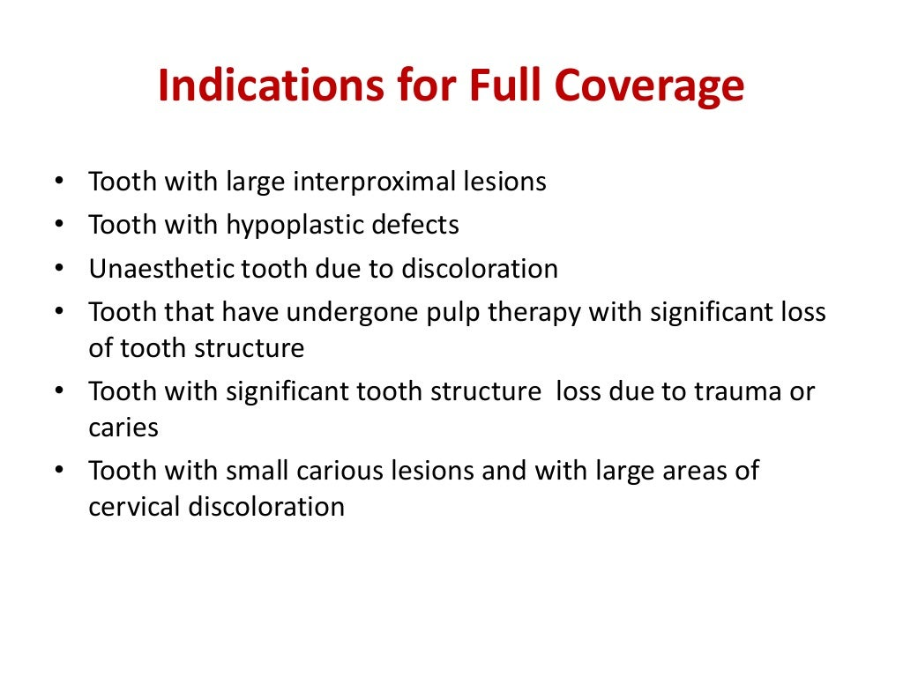

Slide 5
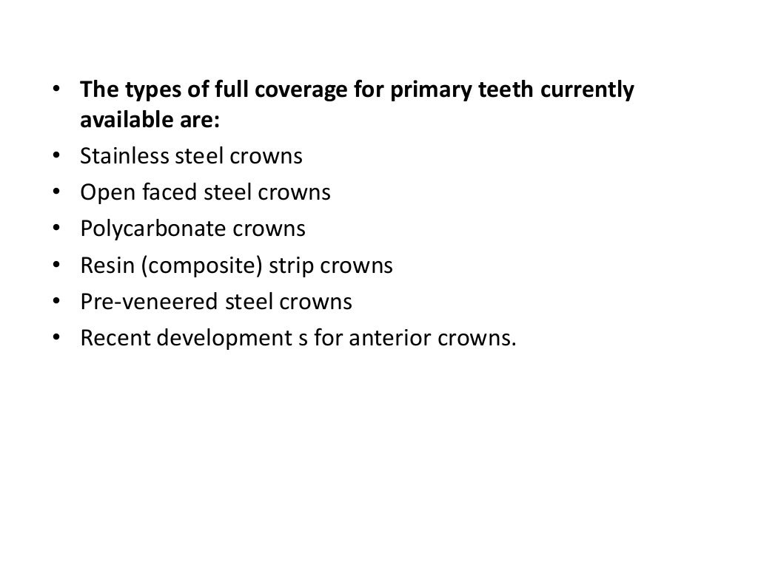

Slide 6
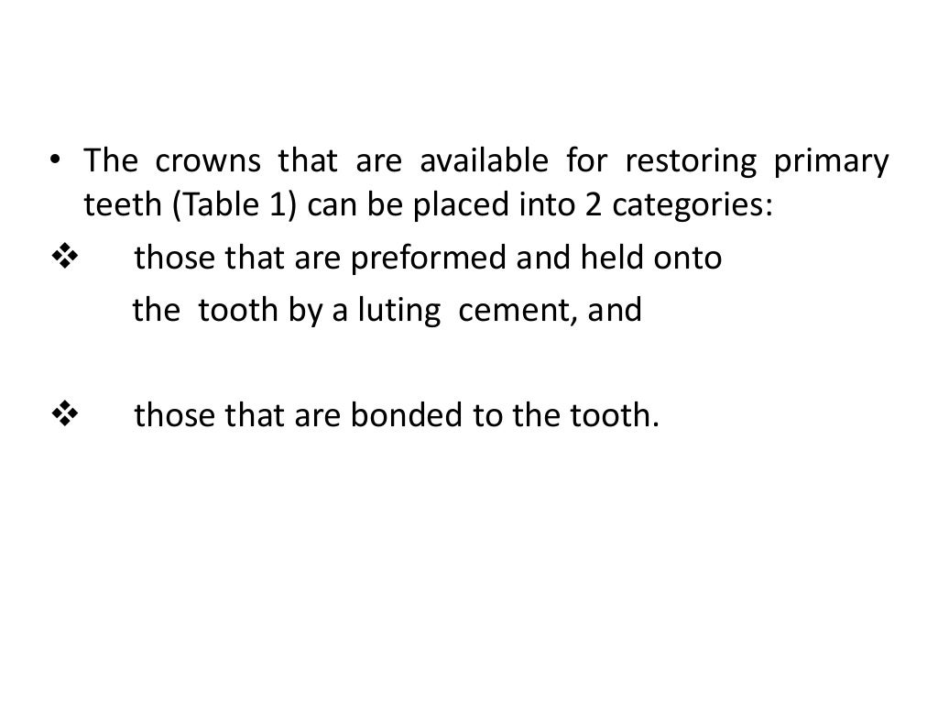

Slide 7
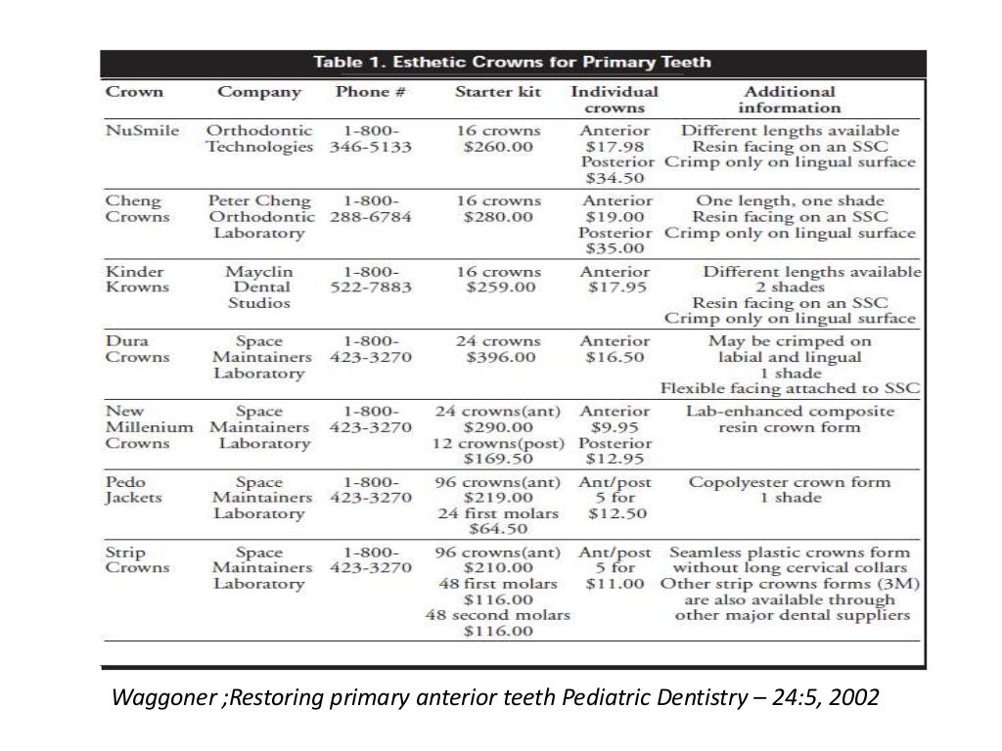

Slide 8
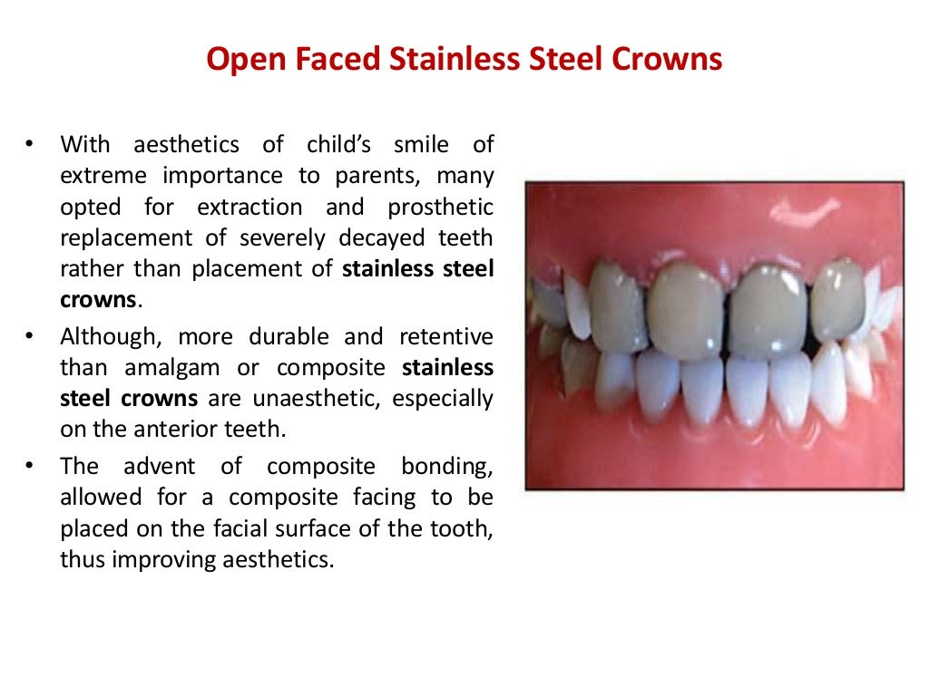

Slide 9
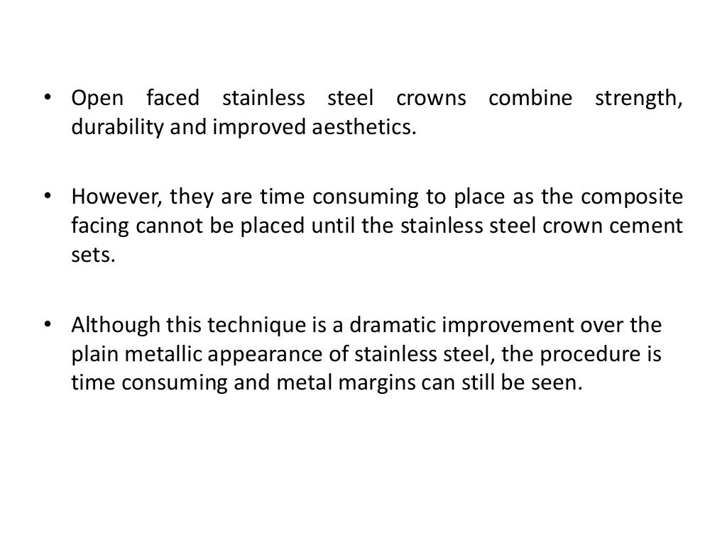

Slide 10
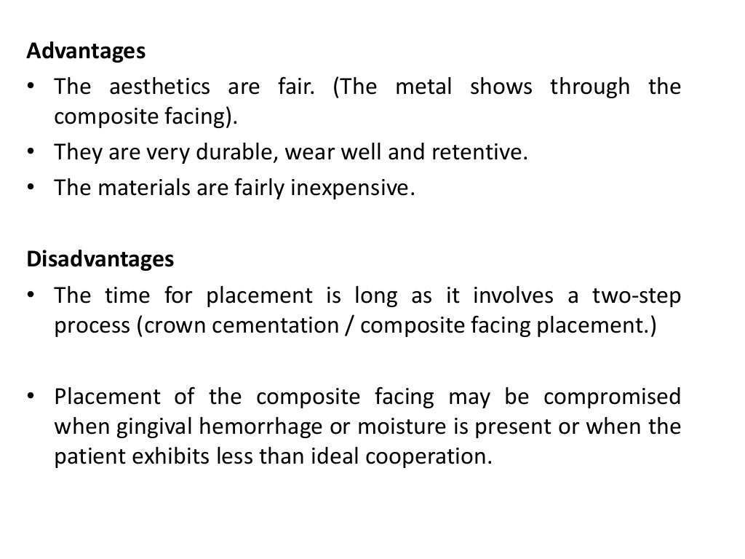

Slide 11
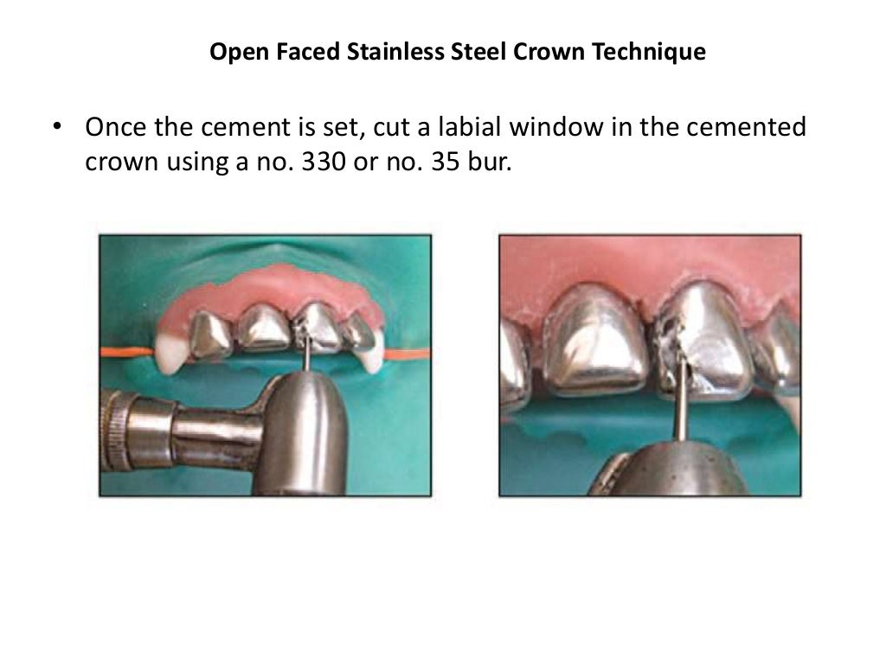

Slide 12
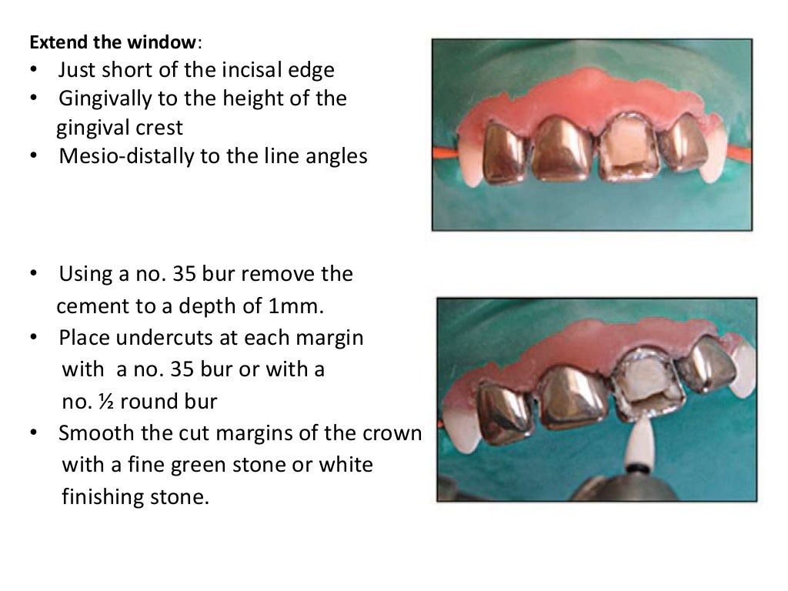

Slide 13
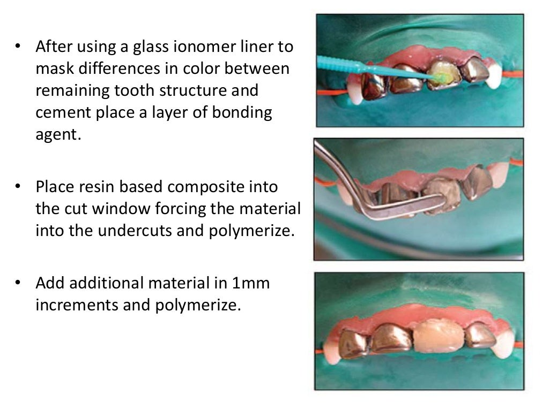

Slide 14
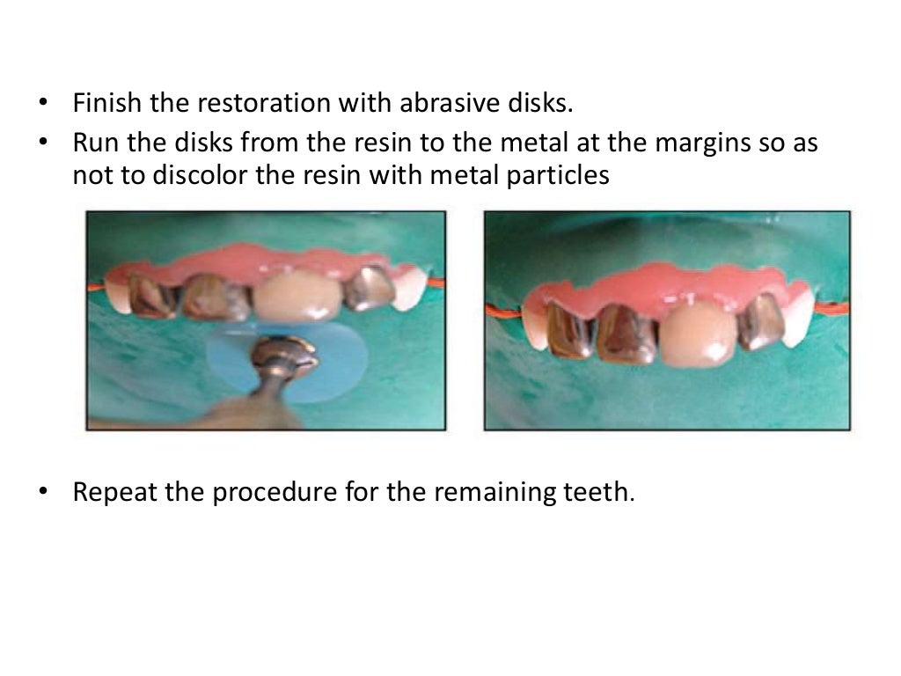

Slide 15
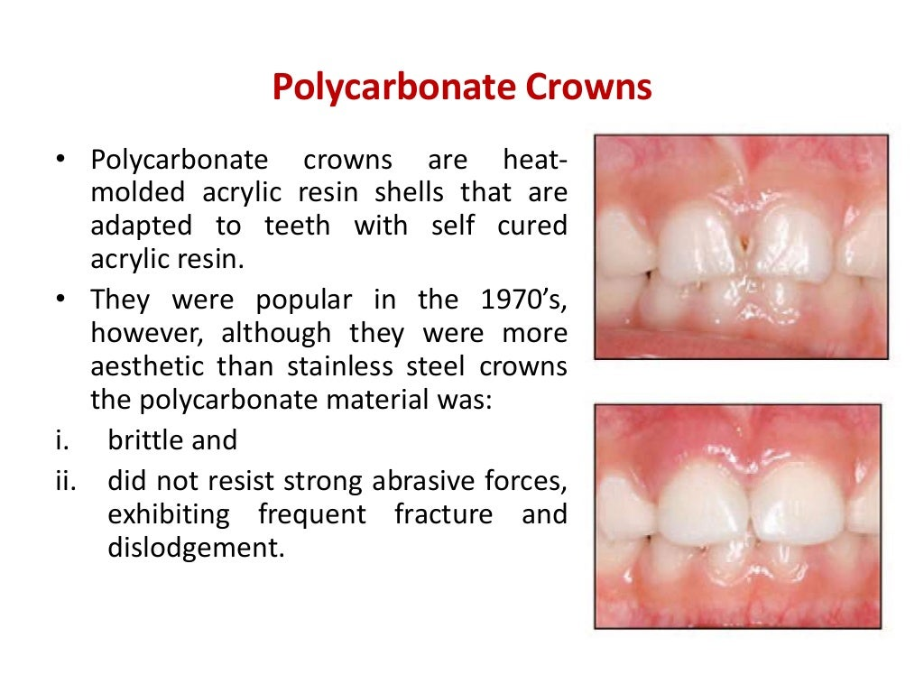

Slide 16
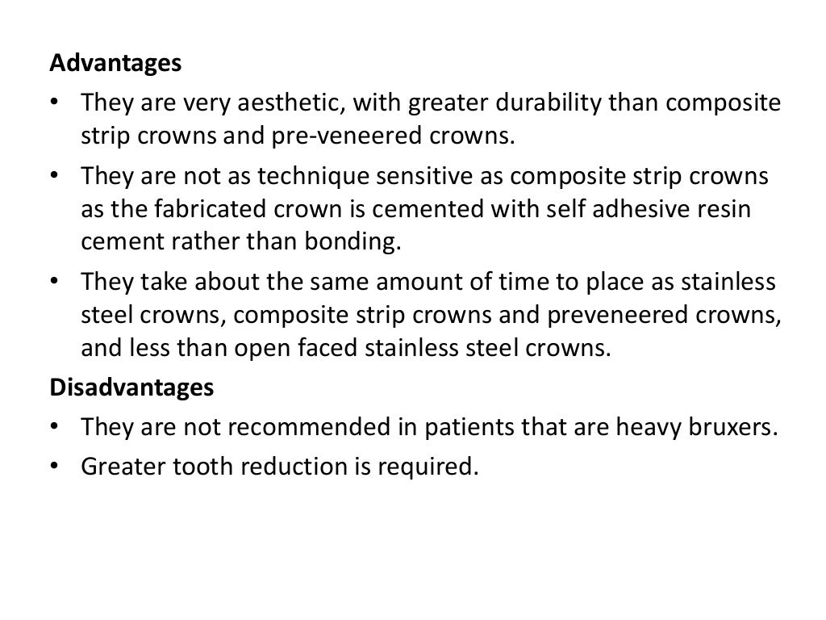

Slide 17
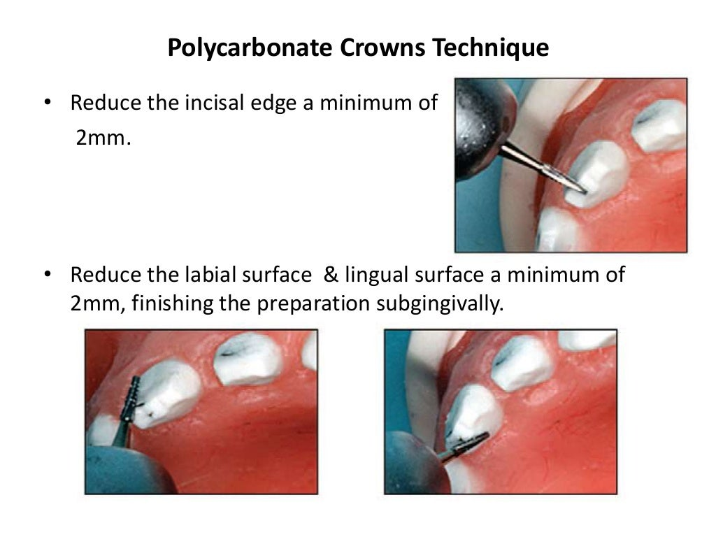

Slide 18
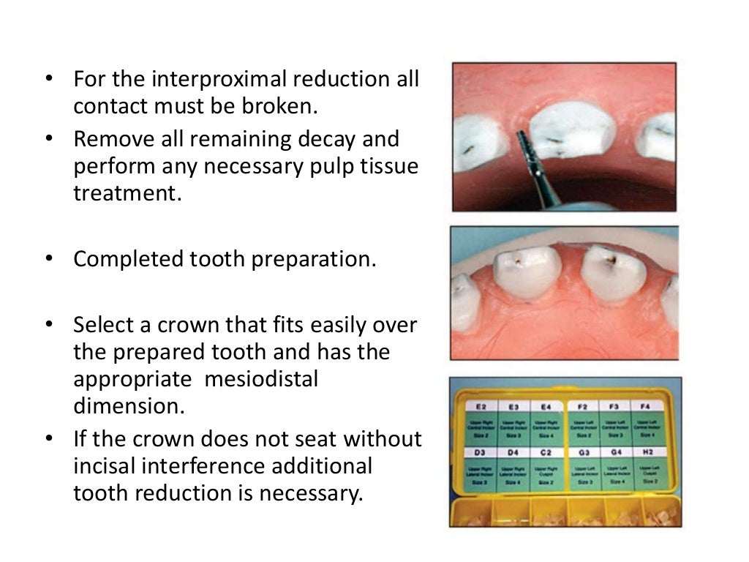

Slide 19
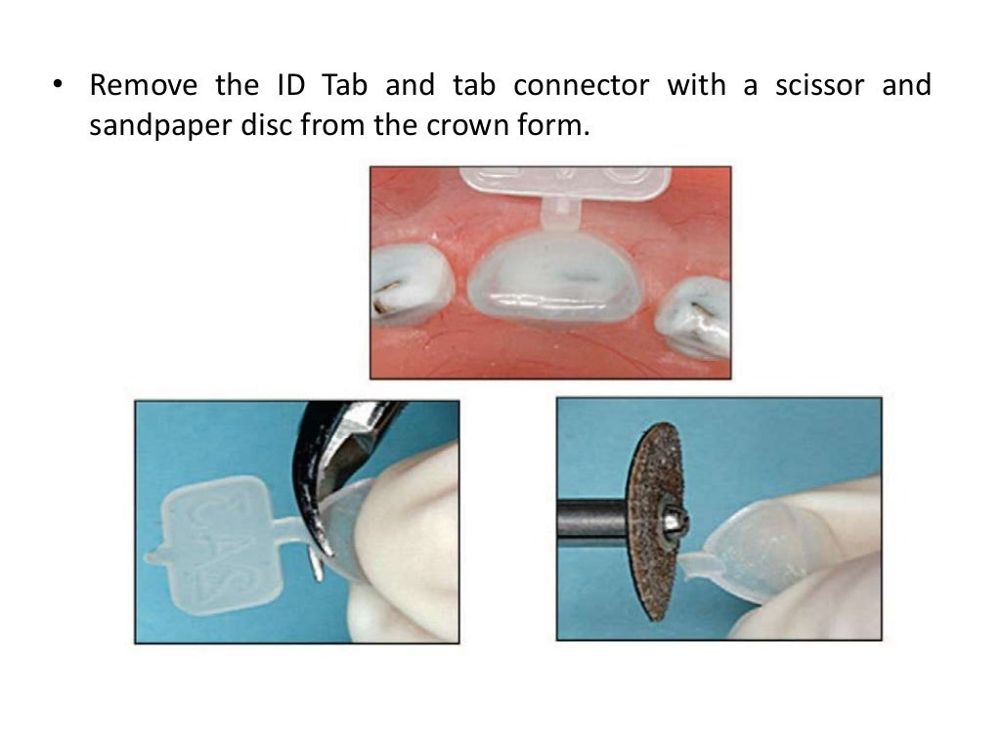

Slide 20
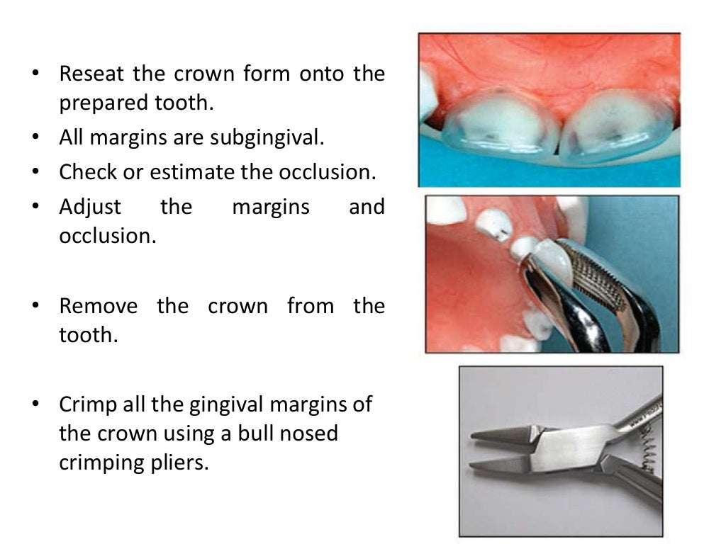

Slide 21
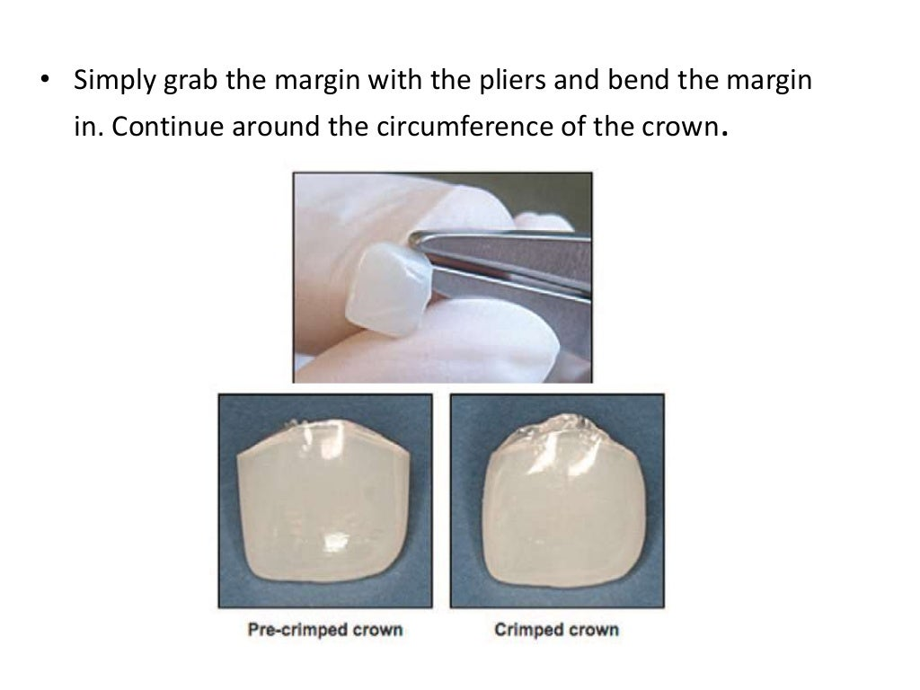

Slide 22
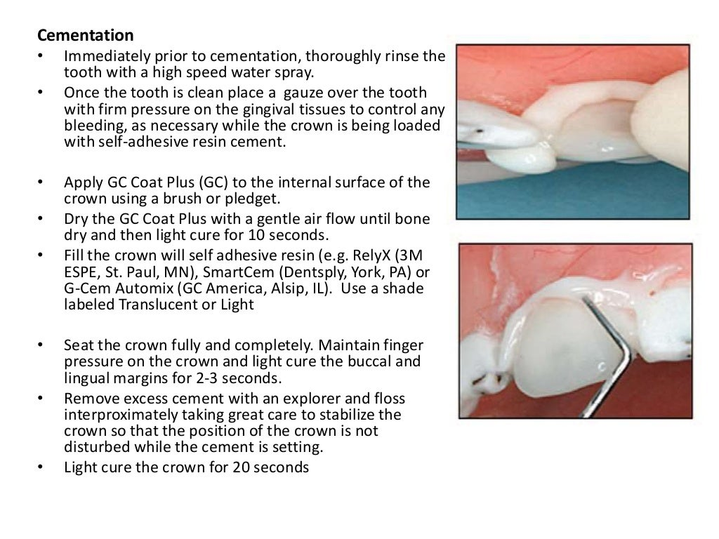

Slide 23
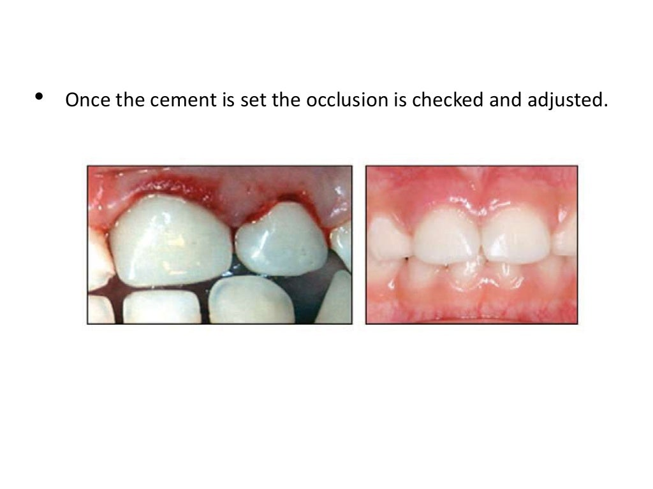

Slide 24
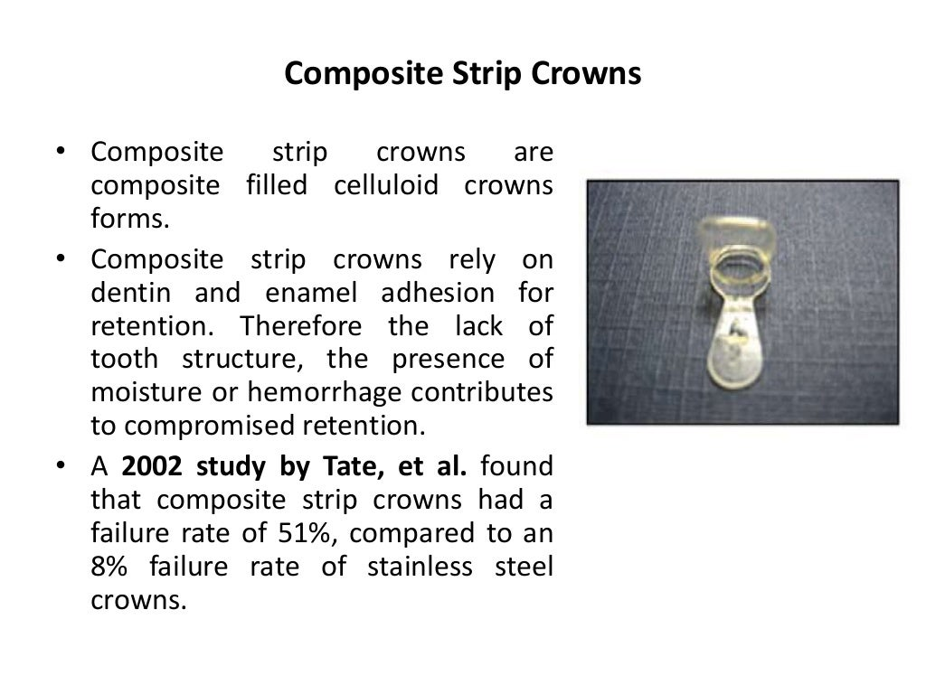

Slide 25
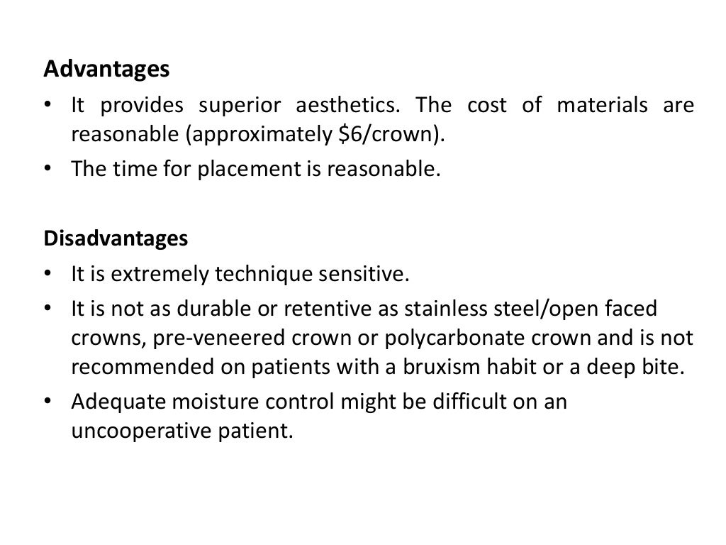

Slide 26
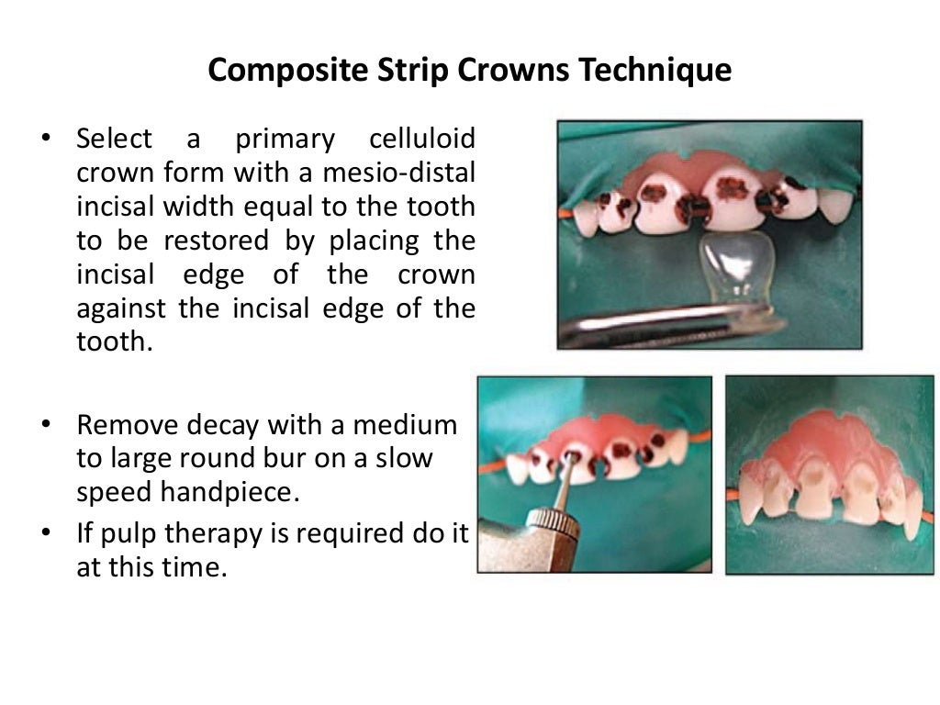

Slide 27
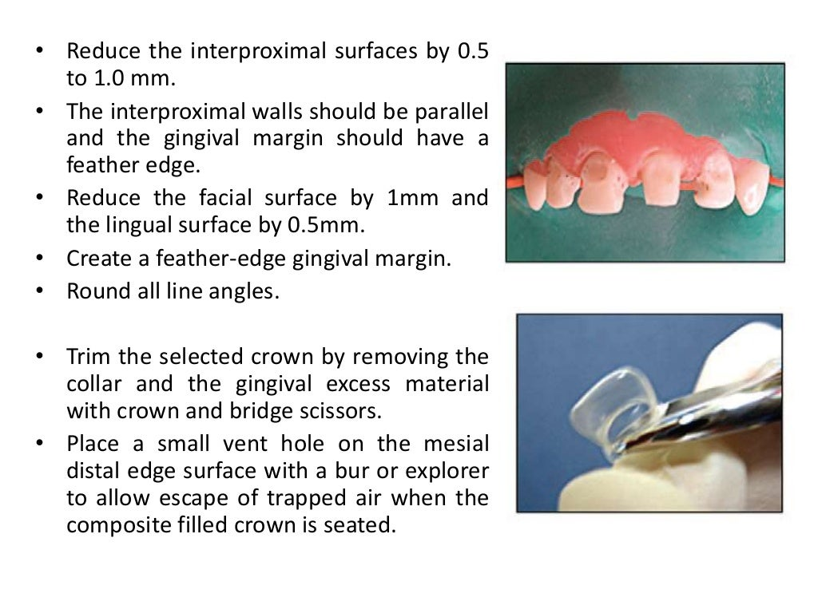

Slide 28
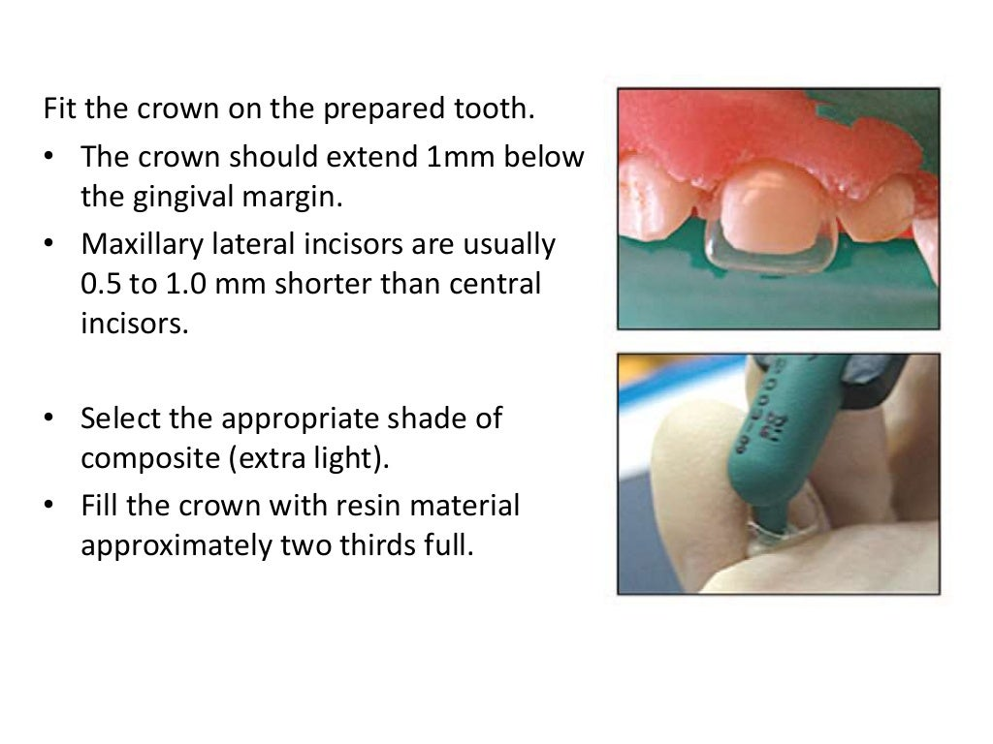

Slide 29
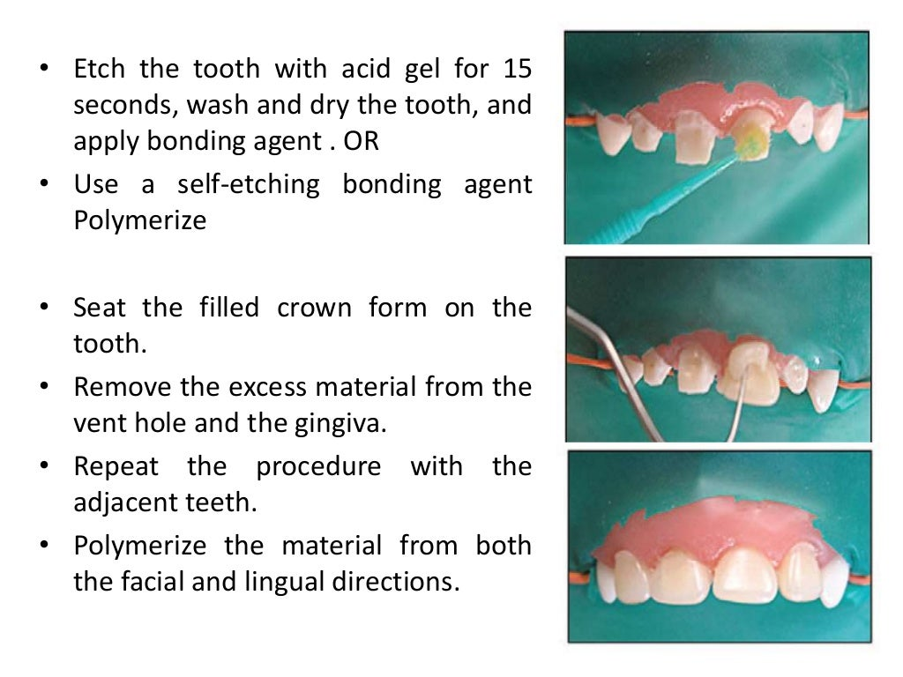

Slide 30
